Slide 1
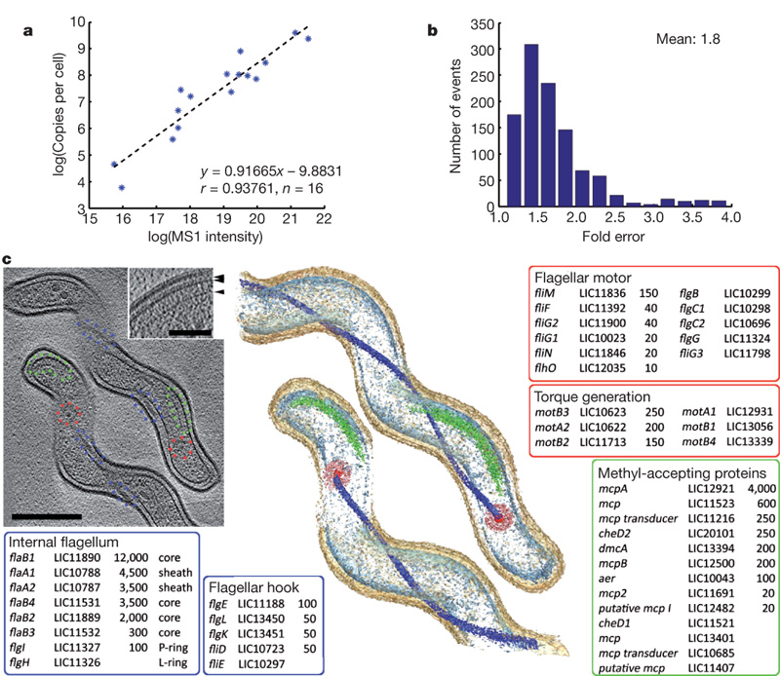

Large-scale determination of cellular protein concentrations.
J Malmström et al. Nature 000, 1-4 (2009) doi:10.1038/nature08184

